Slide 1




[CHAPTER]
[TOPIC]
AIAA Caltech Student Branch – 18/11/20
Preliminary Design Review – H.O.M.E.S.
Header 1
Header 2
Header 3
Body
Note

Slide 2
MISSION INTEGRATION
[TOPIC]
AIAA Caltech Student Branch – 18/11/20
Preliminary Design Review – H.O.M.E.S.
Verification Tests
Vibration Test for Deployment
EMI Test for EDS System
Goal: Validate to TLR4
-All tests under thermal and vacuum conditions
-Implement safety factor of 1.2 – 1.5
Miscellaneous
Maximum Load Test
Abrasion Test
Operational Test
Mechanical Load Tests
600 N Pulsating Fatigue Test
Dust Exposure Test
Sharp Impact Test Simulating Micrometeorites

Slide 3
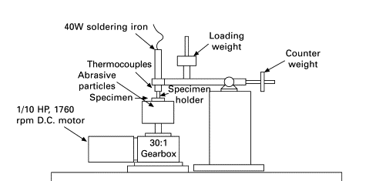
MISSION INTEGRATION
[TOPIC]
AIAA Caltech Student Branch – 18/11/20
Preliminary Design Review – H.O.M.E.S.
Equipment
We will construct a vacuum chamber for our verification tests
Looking for resources for cryochamber
Lunar Simulant JSC-1A will be used for all verification tests
Similar compositional and mineralogical features to actual lunar regolith
Three-Body Abrasive Wear Test Rig
(Roy, 2008)

